Slide 1
Tablut Q-Learning
By Robert Dunski

Slide 2
What is Tablut?
Tablut is an ancient game played in Lapland (northern region of Finland) until around the 18th century.
The game is asymmetric, with both sides (attackers and defenders) having separate win conditions and rules.
Source: http://tafl.cyningstan.com/page/170/tablut

Slide 3
The Rules
1. Tablut is played on a board of 9×9 squares.
2. There are 25 pieces: a king and his eight defenders, and sixteen attackers. These are placed in the shape of a cross with serifs, as in the diagram.
3. The attacking side takes the first move.
4. Pieces move any distance orthogonally, not landing on nor jumping over other pieces on the board.
5. No piece may land on the central square, called the "castle", not even the king once he has left it.
6. A piece other than the king is captured when it is surrounded orthogonally on two opposite squares by enemies. The king can pair up with a defender for the purpose of capturing attackers.
7. A piece may also be captured between an enemy and the empty castle.
8. When in the castle, the king is captured by surrounding him on four orthogonal sides with attackers.
9. When stood beside the castle, the king may be captured by surrounding him on the remaining three sides with attackers.
10. Elsewhere on the board, the king is captured as other pieces.
11. If the king when in the castle is surrounded on three sides by attackers, and on the fourth by a defender, the defender may be captured by surrounding it between an attacker and the king.
12. The king wins the game on reaching any square at the edge of the board. The attackers win if they capture the king.
Source: http://tafl.cyningstan.com/page/170/tablut

Slide 4
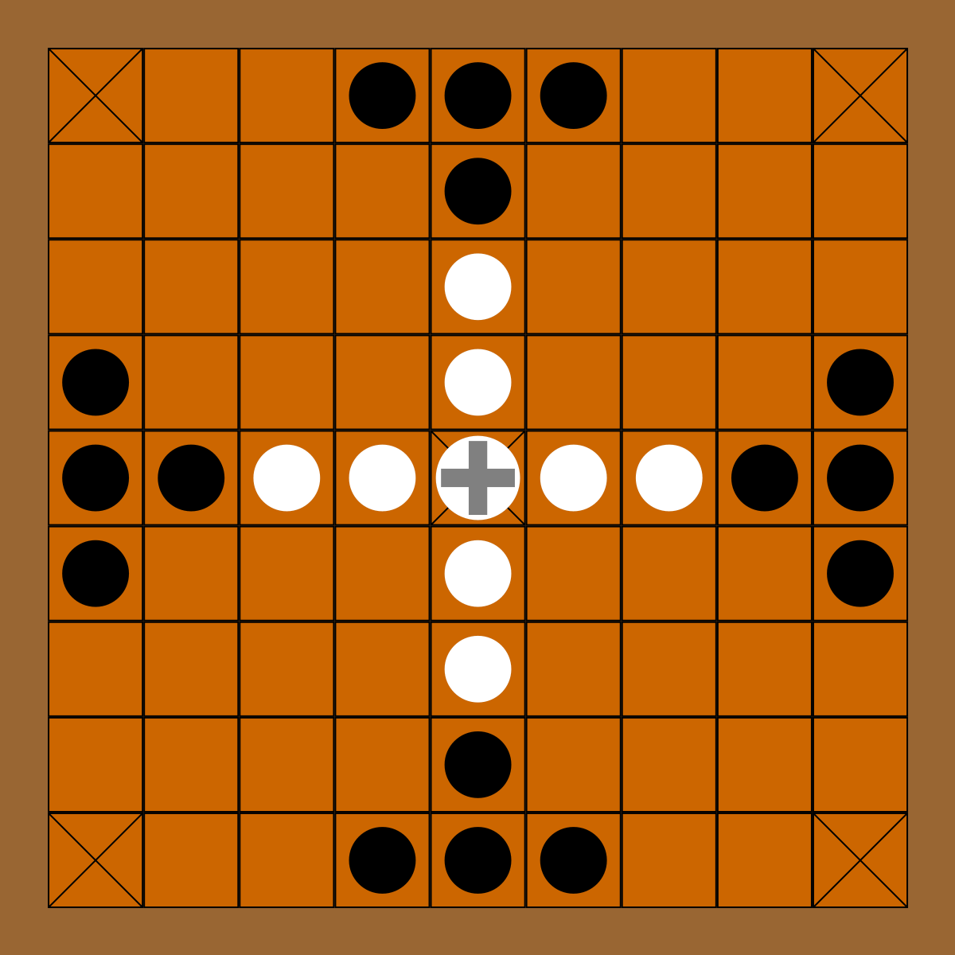
The Board
Board Image Source: https://commons.wikimedia.org/wiki/File:Tablut_board.svg

Slide 5
Attacker Capture
Defender Capture
King Capture
A
D
A
A
D
A
D
A
D
D
A
D
Center Capture
A
A
K
A
X
A
D
A

Slide 6
The Problem & Solution
The goal was to make a reinforcement learning algorithm for both sides of the game, and pit them against each other to see who can win the most out of 100 games.
To achieve this, a simple Q-LearningTable approach to reinforcement learning was taken.

Slide 7
Q-Learning
Q-Learning is a model-free reinforcement learning algorithm.
The value for Q^{new}(s_{t},a_{t}) is inserted into a table, where s_{t}=the current state, and a_{t}=possible action.
Source: https://en.wikipedia.org/wiki/Q-learning

Slide 8
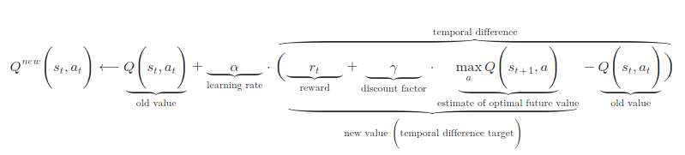
Q-Learning
The algorithm also takes into account several variables:
Reward for performing the action = r_{t}
Discount factor for getting rewards early = 𝛶_{t}
Desired learning rate = 𝛼_{t}
Which gives us:
Source: https://en.wikipedia.org/wiki/Q-learning

Slide 9
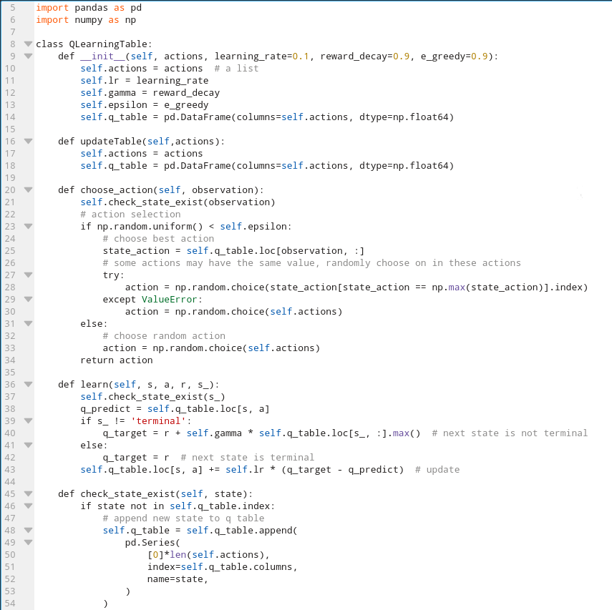
Coding the Algorithm
Code Source: github.com/MorvanZhou/Reinforcement-learning-with-tensorflow/blob/master/contents/2_Q_Learning_maze/RL_brain.py

Slide 10
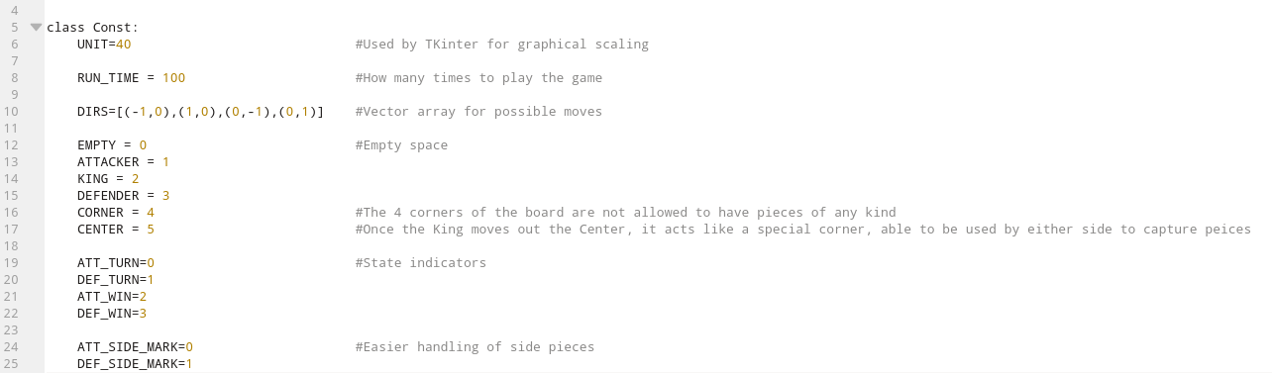
Constants for the Game

Slide 11
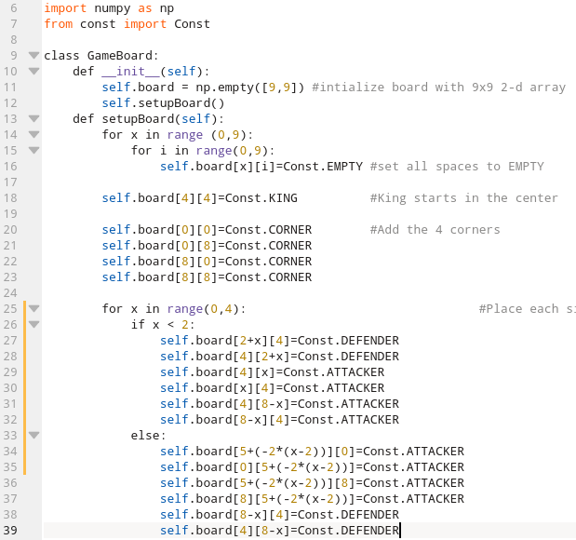
Coding the Board
Black: Attackers
White: Defenders
Board Image Source: https://commons.wikimedia.org/wiki/File:Tablut_board.svg

Slide 12
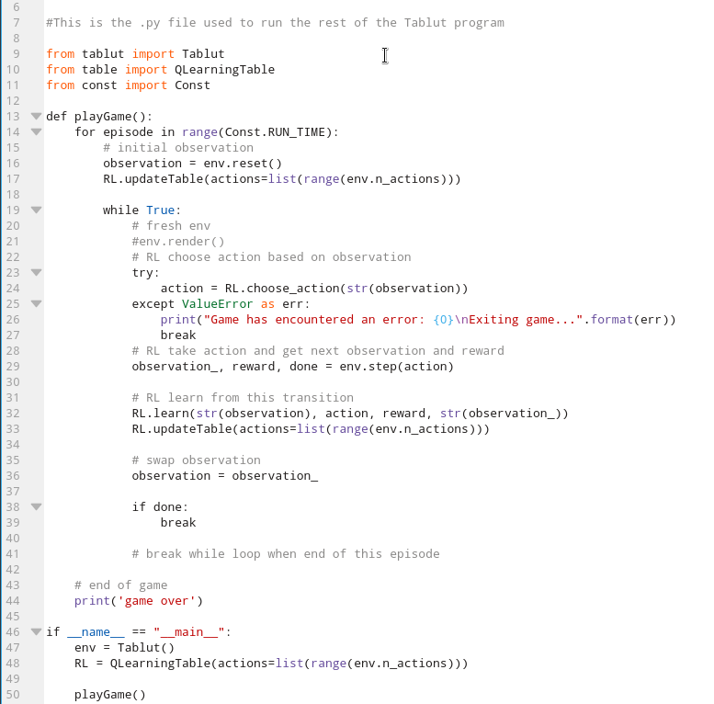
Coding the Main Loop
Code Source: github.com/MorvanZhou/Reinforcement-learning-with-tensorflow/blob/master/contents/2_Q_Learning_maze/run_this.py

Slide 13
Coding the Rest of the Game
The following file is the heart of the program, and is quite large, so follow this link.
To run the game, simply download the files in the tablut folder and run “python play.py”.
(Make sure that pandas and numpy are installed in python.)

Slide 14
Final Results
From one run, Attackers won 15 times, and Defenders won 84 times.
Defenders have a much easier win condition, being able to win in as little as 4 moves, so it makes sense that the Defenders win most of the time.

Slide 15
Thanks for Listening!
By Robert Dunski

